Slide 1
Investigations & medical management of POAG
Dr. Vivekanand. U

Slide 2
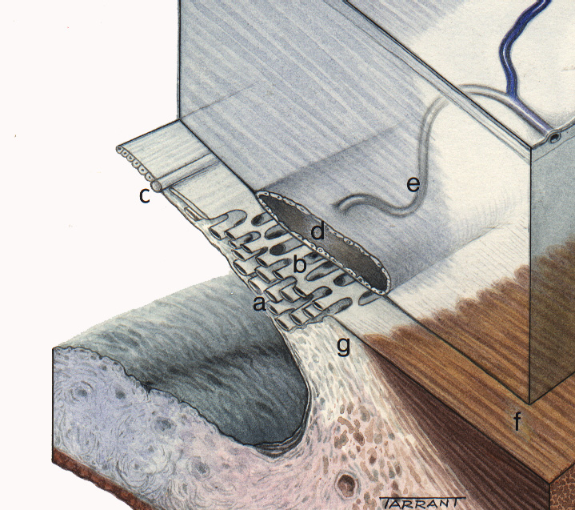
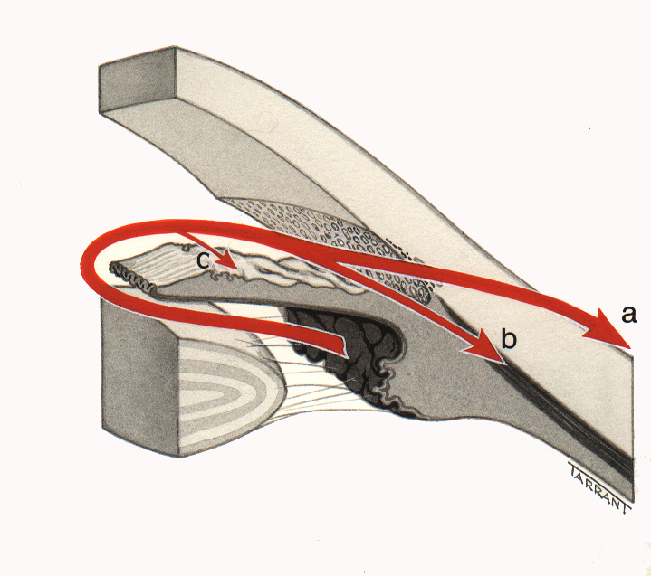
Aqueous outflow
Anatomy
Physiology
a - Uveal meshwork
a - Conventional outflow
b - Corneoscleral meshwork
b - Uveoscleral outflow
c - Schwalbe line
d - Schlemm canal
c - Iris outflow
e - Collector channels
f - Longitudinal muscle of
ciliary body
g - Scleral spur

Slide 3
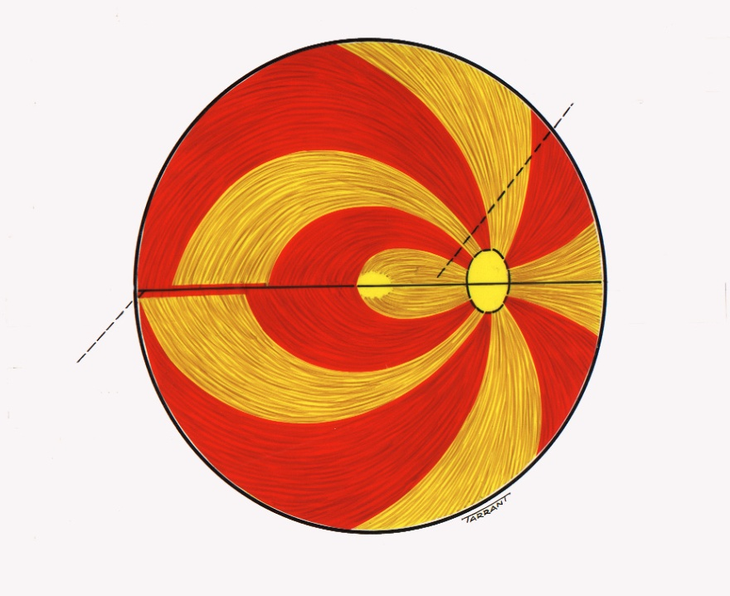
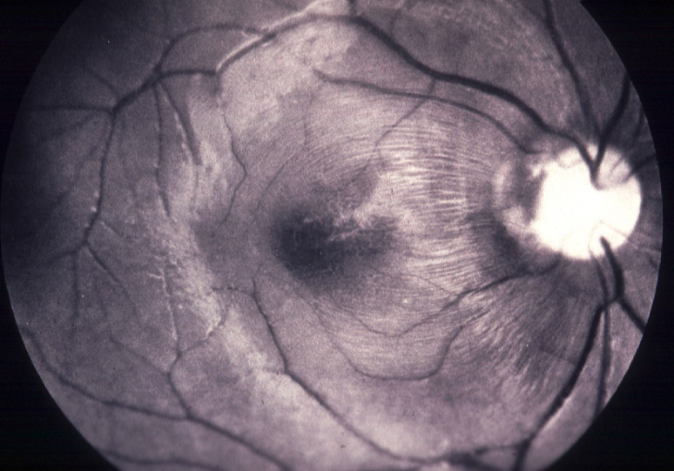
Anatomy of retinal nerve fibres
Papillomacular
bundle
Horizontal
raphe

Slide 4
Investigations
CCT (central corneal thickness)
Tonometry
Gonioscopy (Angle anatomy)
Perimetry (Visual field analysis)
ONH analysis (OCT)

Slide 5
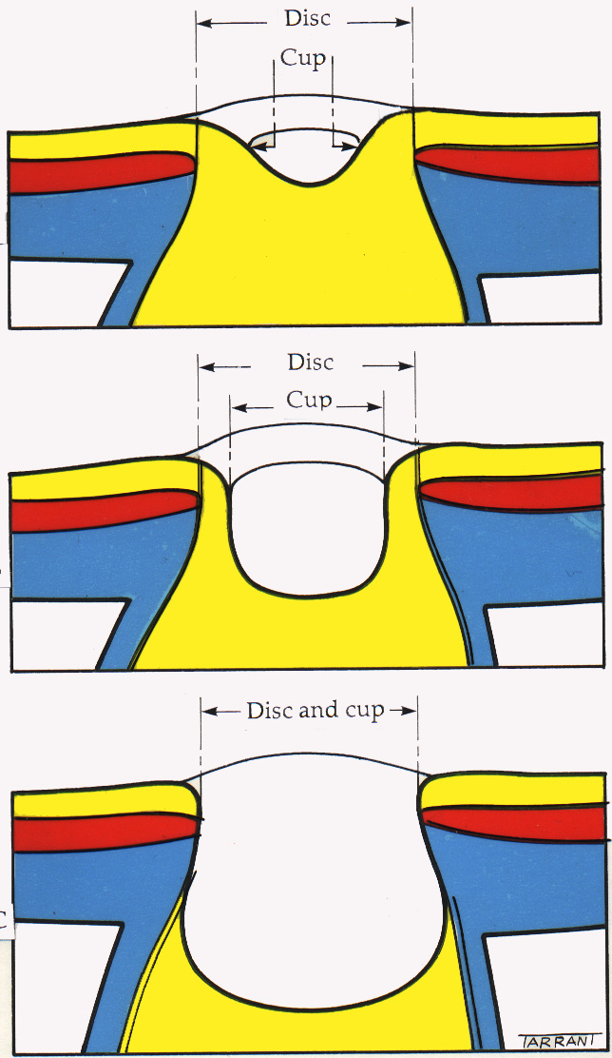
Optic nerve head
Small physiological cup
a
a - Nerve fibre layer
b
b - Prelaminar layer
c
c - Laminar layer
Large physiological cup
Normal vertical cup-disc ratio is 0.3 or less
2% of population have cup-disc ratio > 0.7
Asymmetry of 0.2 or more is suspicious
Total glaucomatous cupping

Slide 6
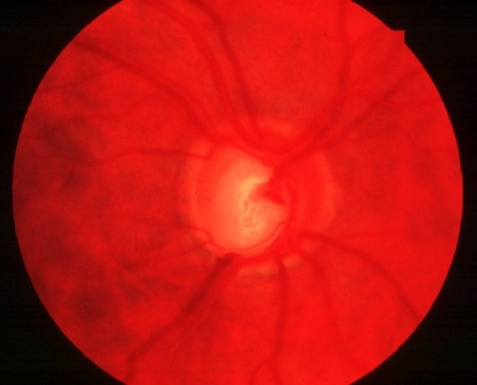
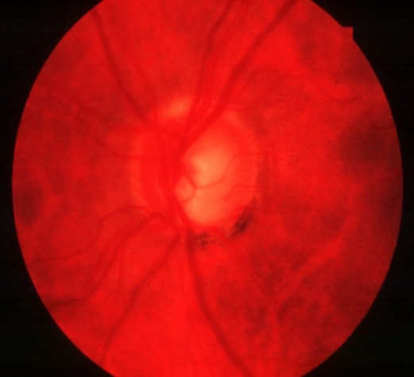
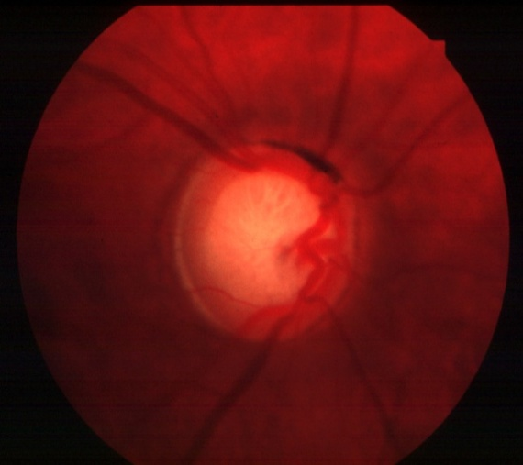
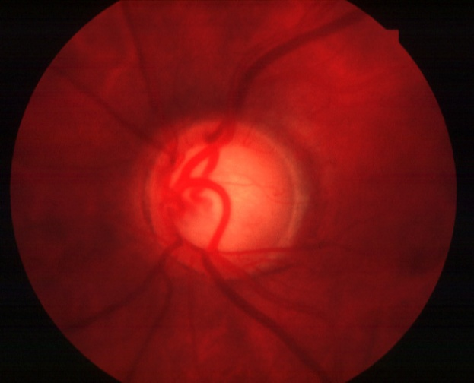
Localized cupping
Focal loss of nerve fibres
Notching at superior or more commonly inferior poles
Excavation becomes vertically oval
Double angulation of blood vessels (‘bayoneting sign’)
Diffuse loss of nerve fibre
Excavation enlarges concentric cupping
Nasal displacement of central blood vessels

Slide 7
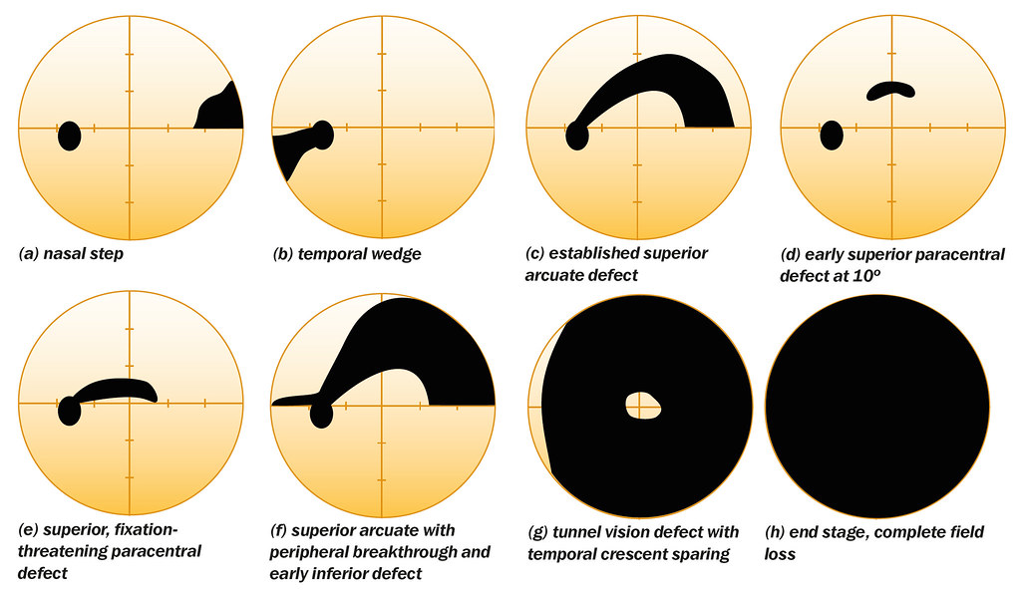

Slide 8
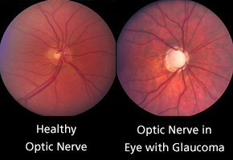

Slide 9
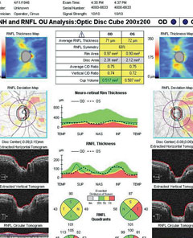

Slide 10
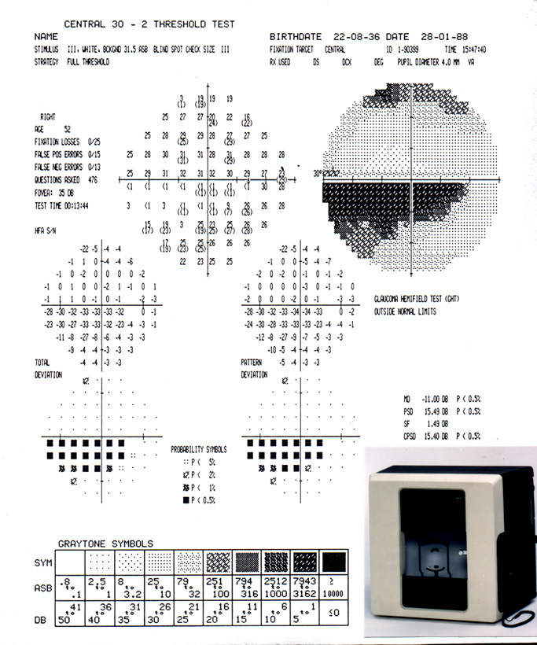
Humphrey perimetry

Slide 11
Pathways to Lower intraocular pressure
Outflow
Inflow
α₂-agonists Cholinergics
Prostaglandins
α₂-agonists
β₁-blockers
CA inhibitors

Slide 12
Drugs to treat glaucoma
1. Beta blockers (Timolol 0.5%, c/i – Asthma)
Sympathomimetics- alpha 2 agonist- brimonidine
3. Miotics – (Pilocarpine)
4. Prostaglandin analogues ( latanoprost, brimatoprost)
5. Carbonic anhydrase inhibitors
Topical ( Dorzolamide, brinzolamide)
Systemic ( Acetazolamide)
6. Hyperosmotic agents- Mannitol, Glycerol

Slide 13
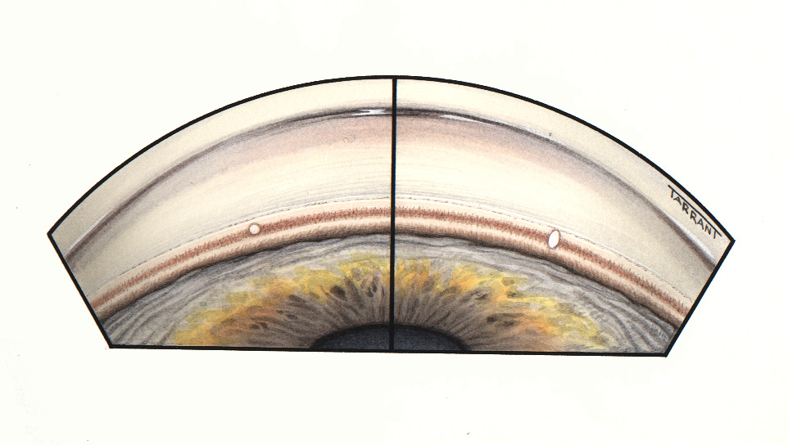
Laser trabeculoplasty
Indications
Failed medical therapy
Primary therapy in non-compliant patients
Application of 50-100 burns
Incorrect focus with oval
aiming beam
to junction of pigmented and
non-pigmented trabeculum
Correct focus with round
aiming beam

Slide 14
Indications for Trabeculectomy
1. Failed medical therapy and laser trabeculoplasty
2. Lack of suitability for trabeculoplasty
Poor patient co-operation
Inability to adequately visualize trabeculum
3. As primary therapy in advanced disease

